Slide 1
Literature Review Guidelines
Science Fair Paper Tips!

Slide 2
Overview of Literature Review
Literature reviews are designed to do two things:
give your readers an overview of sources you have explored while researching a particular topic or idea
demonstrate how your research fits into the larger field of study, in this case, science.

Slide 3
Annotated Bibliographies
You might scream: “Isn’t this just basically an annotated bibliography?”
I scream: “NO. That’s just a list of references and summaries and critiques listed in alphabetical order. Big deal. Any old goober could do that.”
You scream back: “I don’t want to be a goober! How do I do this then!?”

Slide 4
The Basic Thread of all Lit Reviews:
Once you decide on your topic, you will need to draw quotes from and paraphrase the sources that you have found, and you must MUST MUST include in-text parenthetical citations with a reference list at the end of the document.

Slide 5
The Process for Non-Goobers
Choose a variety of articles that relate to your subject, even if they do not directly answer your research question. You may find articles that loosely relate to the topic, rather than articles that you find using an exact keyword search.
At first, you may need to cast a wide net when searching for sources.
This will help you narrow your topic later.

Slide 6
An Example!
If your research question focuses on how people with chronic illnesses are treated in the workplace, you may be able to find some articles that address this specific question.
You may also find literature regarding public perception of people with chronic illnesses or analyses of current laws affecting workplace discrimination.
This additional information will round out your topic and provide unexpected and welcome detail and analysis for your reader.

Slide 7
Once Articles Have Been Found!
Select the most relevant information from the articles as it pertains to your subject and your purpose.
Remember, the purpose of the literature review is to demonstrate how your research question fits into a larger field of study.

Slide 8
Non-Goobers Must Think Critically
Critically examine the articles.
Look at methodology, statistics, results, theoretical framework, the author's purpose, etc.
Include controversies when they appear in the articles.
* Uncover and explore what unites the findings among these articles. You will want to seamlessly blend information from a variety of sources in each paragraph.*

Slide 9
Another Example!
You should look for the strengths and weaknesses of how the author conducted the study. You can also decide whether or not the study is generalizable to other settings or whether the findings relate only to the specific setting of the study.
Ask yourself why the author conducted the study and what he/she hoped to gain from the study. Look for inconsistencies in the results, as well.

Slide 10
After You Think Critically… Organize
Organize your information in the way that makes most sense.
Some literature reviews may begin with a definition or general overview of the topic.
Others may focus on another aspect of your topic. Look for themes in the literature or organize by types of study.

Slide 11
Confirm That You Are Answering The Question
Make sure the information relates to your research question/thesis.
You may need to explicitly show how the literature relates to the research question; don't assume that the connection is obvious.

Slide 12
Critical Assessment, Not a Summary
Check to see that you have done more than simply summarize your sources.
Your literature review should include a critical assessment of those sources.
Be sure to develop questions for further research. Again, you are not simply regurgitating information like a mommy bird into its gross baby bird’s beak, but you are leading your reader to questions of your own, questions and ideas that haven't been explored yet or haven't been addressed in detail by the literature in the field.

Slide 13
Structure
Now you’re screaming: “How is a literature review structured?”
Like any expository essay, a literature review should have an introduction, body, and conclusion.
The introduction should contain your research question, an explanation of its significance, and any other background information setting the context of your research.
The body paragraphs contain your summative, comparative, and evaluative comments on the sources you've found. These comments may pertain to the following:

Slide 14
The Body Paragraphs!
historical background & early research findings
recent developments
areas of controversy among experts
areas of agreement
dominant views or leading authorities
varying approaches to or perspectives on the subject
qualitative comparisons and evaluations
Among other things.

Slide 15
The Conclusion
The conclusion summarizes major issues in the literature; it also establishes where your own research fits in and what directions you see for future research.

Slide 16
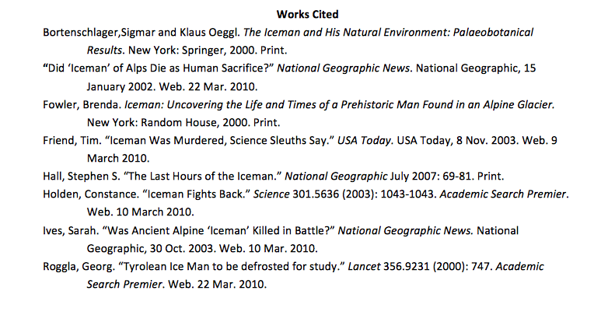
At the End…
You must have a Works Cited page. What Do you notice about the following?

Slide 17
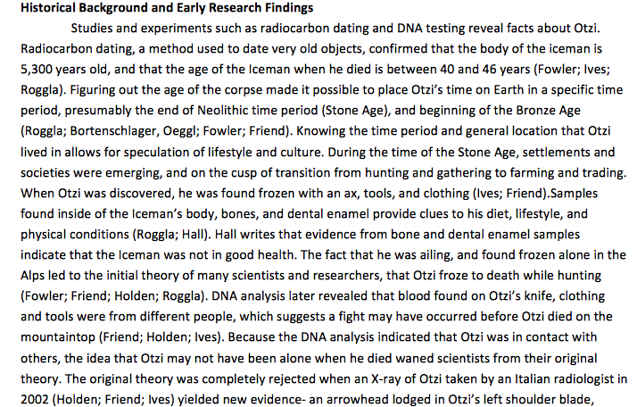
Always Cite Your Work…
We follow MLA guidelines, so remember: always cite your work, whether it be a direct quote or a paraphrase. Here is a sample paragraph taken from a literature review:

Slide 18
Now you can scream:
I know what to do! I’m so smart! I can do anything!
I’m not a goober!
Come and see me if I can help you further.

