Slide 1
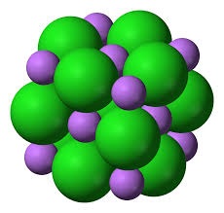
While waiting for the bell to ring:
Pick up the handout.
On a clean sheet of paper in your notebook, write Practice Free Response Explanations.
Under today’s date, answer the following questions using the information provided in the table:
Write the complete electron configuration for the Na¹⁺ ion in the ground state.
Using principles of atomic structure, explain why the Na¹⁺ ion is larger than the Li¹⁺ ion.
Below is a representation of a portion of a crystal of lithium chloride. Identify the ions in the representation by writing the appropriate formulas (Li¹⁺ or Cl^{l-}) in the boxes.
Ion | Ionic Radius (pm)
Li¹⁺ | 76
Na¹⁺ | 102

Slide 2
Sample Responses to #2
The Na¹⁺ ion has a full 2nd energy level, in addition to its 1st. Li¹⁺ only has 1 energy level. The extra level of electrons makes the radius of Na¹⁺ much bigger than that of Li¹⁺
The Na¹⁺ ion is larger than the Li¹⁺ ion because Na¹⁺ has more electrons and more energy levels than Li¹⁺ has, therefore the ion has a greater size.
The sodium ion is larger than the lithium ion because it has more energy levels which causes electron shielding (repulsive forces between electrons)and therefore increases distance between them.

Slide 3
Additional Questions for the Virtual Lab
Link to virtual lab
Which metal would you most likely find in the free uncombined state in nature? Explain.
Which metal would you least likely find in the free uncombined state in nature? Explain.
Which metal would have been a better substitute for copper in the Statue of Liberty? Explain why it may not have been chosen.

